Slide 1
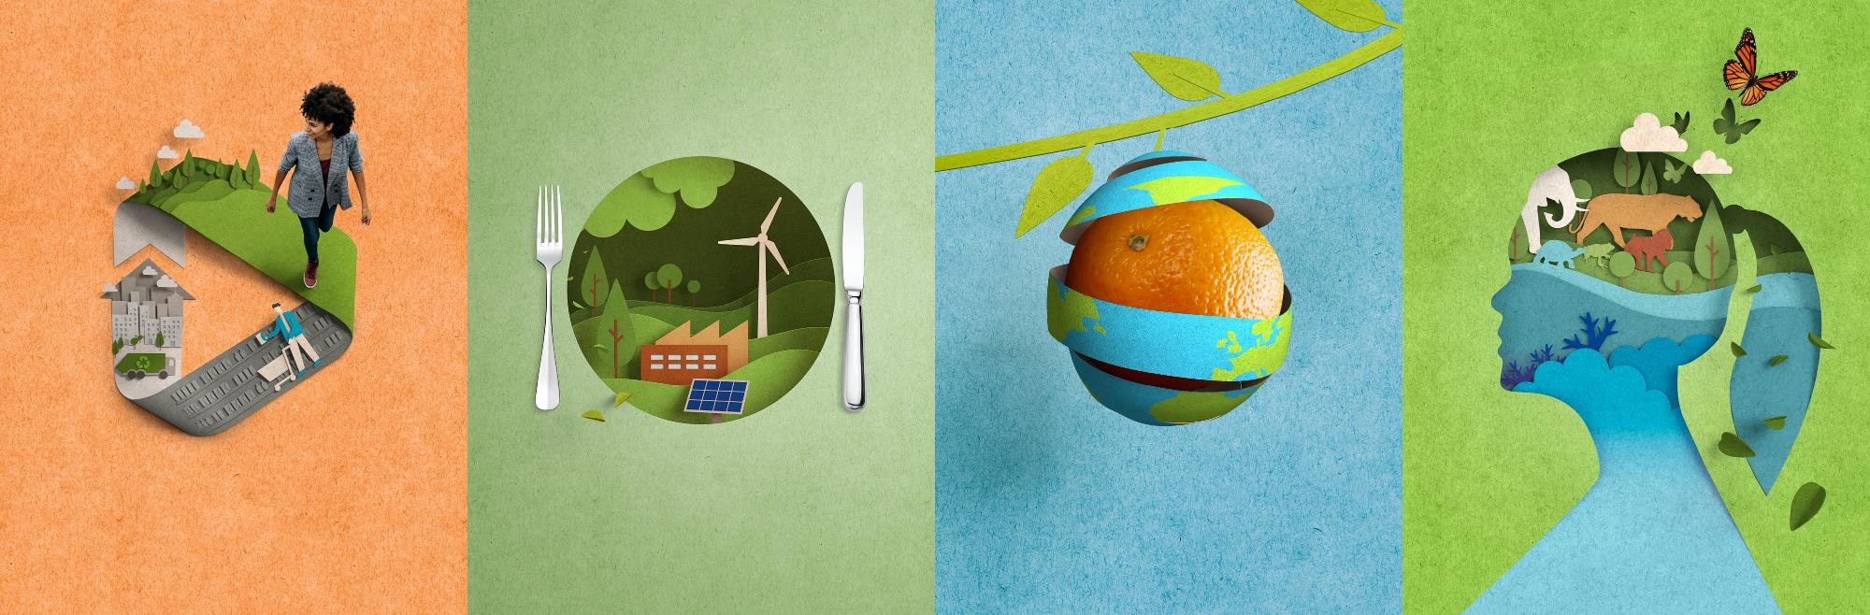
Current Status and Challenges of the Circular Economy
Kristiina Veitola, Director Circular Economy and Packaging Policy
10 December 2024

Slide 2
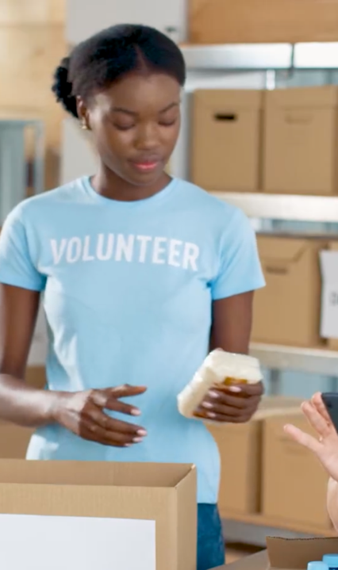
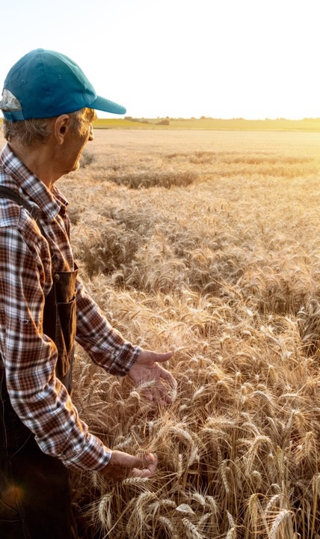
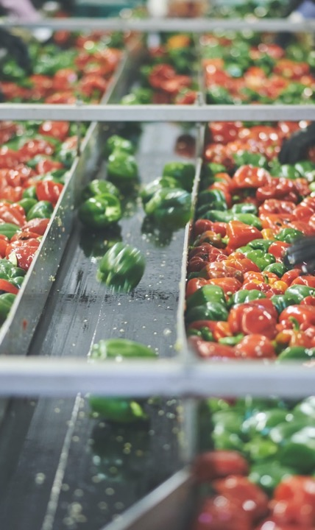

Today's global food systems are unsustainable, posing health, environmental, and socioeconomic challenges
Global food systems account for more than
1/3
of global greenhouse gas emissions².
2.4
billion
people struggle to
get regular access
to sufficient food¹.
More than a
3rd
of all food is
lost or wasted³.
1. https://www.un.org/sustainabledevelopment/hunger/ 2. https://www.nature.com/articles/s43016-021-00225-9 3. https://www.saveonethird.org/

Slide 3
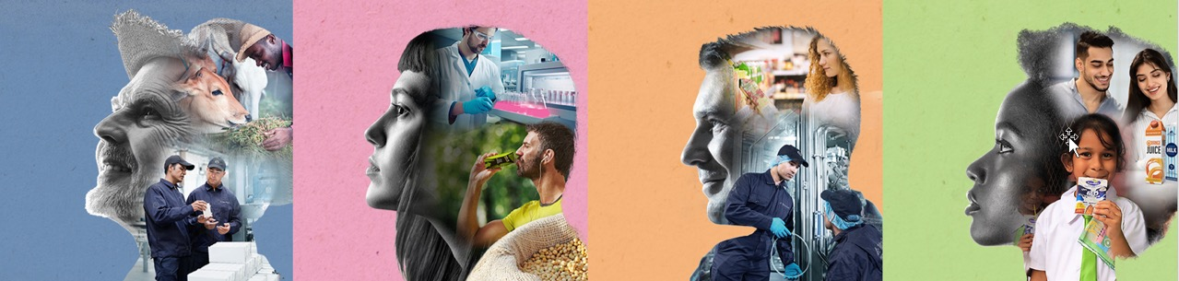
We have identified four pathways to support the transition
Enabling transition towards more sustainable dairy¹.
Innovating for new food sources².
Reducing food loss and waste.
Scaling access to safe nutrition through sustainable food packaging³.
Sustainable dairy is defined as a dairy industry that emits less greenhouse emissions by introducing technologies, equipment and best practices in production and processing to safeguard nutrition security and sustain a billion livelihoods for tomorrow, while helping secure a future for us all. Read more at Global Dairy platform
New food sources is a term broadly referring to any food ingredient that lacks an established history of human consumption, or ingredients made from innovative new processes. Also referred to as “novel foods”. Precise legal definitions vary from region to region.
Sustainable food packaging is defined as a packaging that achieves its functional requirements with minimal environmental impact, that is made from responsibly sourced renewable or recycled materials, is recyclable, and has low carbon footprint in regards to manufacturing, production, shipping, and recycling.

Slide 4


Circularity
and recycling.
Our ambition.
How we do it?
Drive circular solutions by designing recyclable liquid food packaging, using recycled and renewable materials, and expanding collection and recycling to keep materials in use and out of landfills
Investing approximately €100 million per year over the next 5-10 years to further develop sustainable packaging solutions
Investing around €120 million in the collection and recycling local ecosystems in the coming 3 years to increase the effective recycling rate
Taking a leading role in industry collaborations focusing on collection and recycling of carton packages

Slide 5
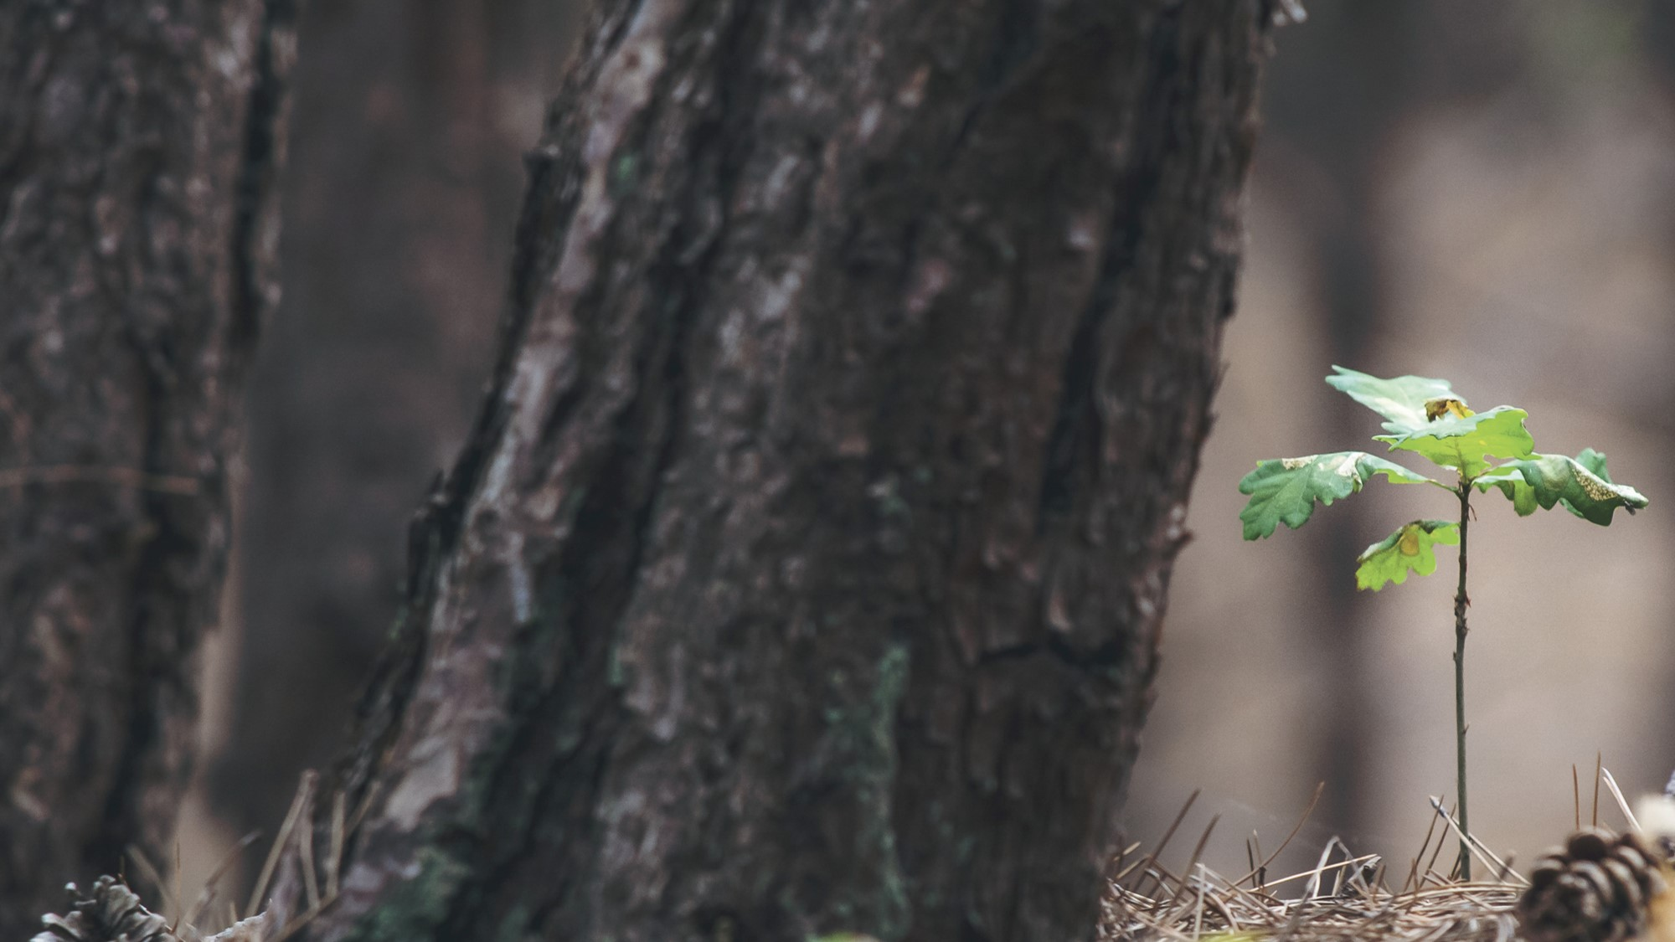



Tetra Pak packaging portfolio strategic objectives
Secure solutions to
decarbonize
Secure circularity
of portfolio
Sustainable openings
Recycled content
Renewable package
Enable recycling by design

Slide 6
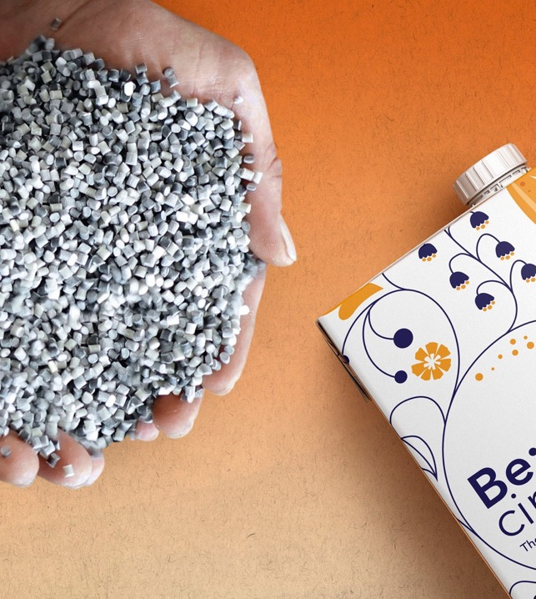
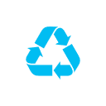
Challenges
CIRCULARITY
Policy should incentivise and reinforce the Economic model and cross-sectoral ecosystem thinking
Circularity by Design should be the basis of all policy
Food Packaging need to be recognized as an essential part of the food system.
Circular Economy and Food Safety policies need to be developed hand in hand.
.

