Slide 1

Japanese defense market
- An overview –
EU-Japan Centre Defence Business Mission
Pre-departure Meeting
April 11, 2025

Slide 2
Defence market
Main characteristics
Constitutional limitations -> Domestic focus
Limited market size
Dominance by small number of domestic large players
US-oriented and dependent (Japan-US Alliance)
Security of Supply Arrangement (SOSA)
Memorandum of Understanding for Research, Development, Test and Evaluation Projects (RDT&E)
Notes:
Limited in size (Until recently)
SOSA and Memorandum of Understanding for Research, Development, Test and Evaluation Projects (RDT&E)
https://www.defense.gov/News/Releases/Release/Article/3267110/dod-japan-mod-sign-technology-and-security-of-supply-arrangements/
Through the SOSA, the United States and Japan agree to exchange reciprocal priority support for goods and services that promote national defense. The arrangement creates a streamlined mechanism for DoD and MOD to request expedited handling of industrial resources to resolve unanticipated supply chain disruptions to meet national security needs.
Japan has difficult relationships with ALL its neighbours,

Slide 3
Recent developments/challenges
Rapid increase in defense budgets in recent years (-> 2%)
Increased export & international activities
Difficulty to maintain capacity
Security policy transformed in 2022
Three key security documents driving developments
National Security Strategy (NSS)
National Defense Strategy (NDS) & Program Guidelines
Multi-domain Defence Force (synergies between land, sea, air plus (cyber) space/electromagnetic spectrum)
Defense Buildup Program (Medium-Term Defence Program)
Tense relations with all its direct neighbours
Territorial/historical
Increased withdrawals from the market (both large and small companies)
Notes:
Budget: uncertainty, more expected also outside of US
Export: Expert of Japan-made Patriot missiles; Radar to Philippines, Bid to build Australian warships; providing maintenance services for US Navy in order to support domestic industry.
Capacity: Joining the SDF is not a popular career choice, with is exacerbated by ageing of society. (Pool of young people is getting smaller)
MOD has about 10.000 SMEs as suppliers, but many are ceasing their business activities (ageing) Dependence on Foreign suppliers are usually as a risk in terms of supply and speed of repairs/service.
Withdrawals: including prime contractors
- Komatsu; Light armoured vehicles (2019)
Daicel: ejection seats for JASDF (2020)
Mitsui Holdings, naval vessels (2021) -> taken over by Mitsubishi Heavy Industries

Slide 4
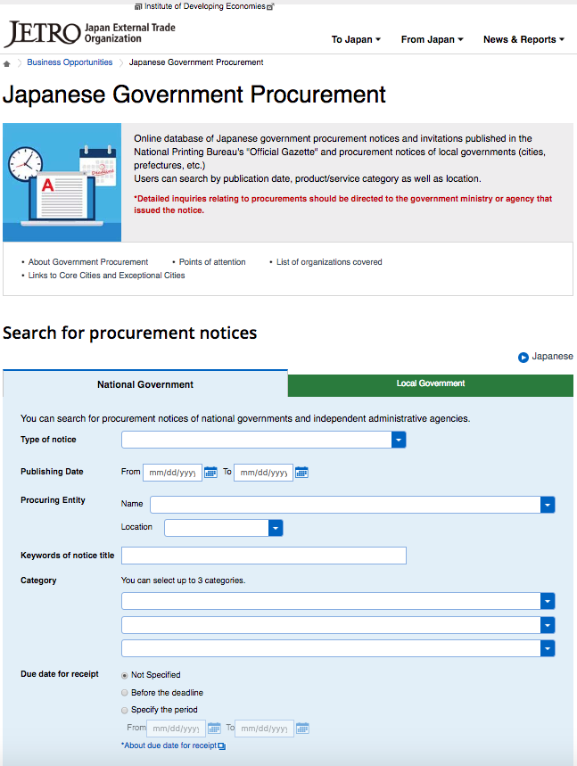
Defense procurement
Internationally regulated procurement
Ministry of Defense (0010)
‘Civilian’ procurement only (FY2024: 287 contracts)
Medical equipment; Office supplies & equipment; Audiovisual equipment; General industrial machinery & equipment
Some EU-multinational companies are direct suppliers, such as Sanofi (Vaccines) and Siemens Healthcare (Medical Equipment).
Internationally regulated procurement
WTO Agreement on Procurement (GPA)
EU-Japan Economic Partnership Agreement (EPA)
Information in English at JETRO Government procurement portal
GPA and EPA do not apply to goods and services required for protection of national security interests
Notes:
Japan is party to the WTO Agreement on Procurement (GPA) and there are also commitments laid down in the EU-Japan Economic Partnership Agreement (EPA). The Ministry of Defense conducts contracts for civilian products and services in accordance with these agreements. They can be found at the JETRO government procurement portal. You can use the QR code to access the JETRO page
The GPA and EPA do not apply to goods and services required for protection of national security interests. The definition of this is quite broad.

Slide 5
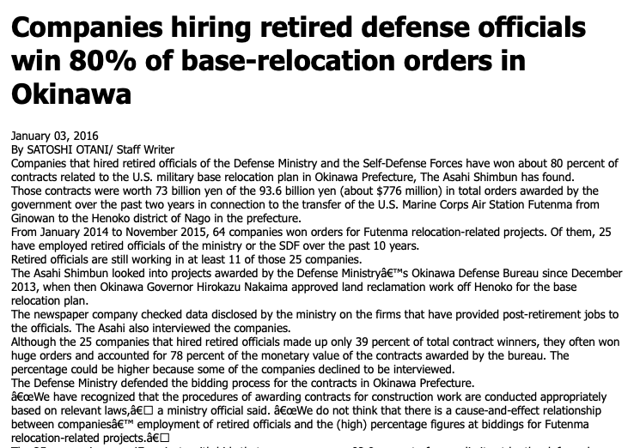
Some general peculiarities and issues of Japanese government procurement
Japanese language only
Strong domestic focus, that is reflected in the procedural structures of government procurement
Local presence implied in tendering
Supplier registration and vetting required in advance
Strong established and preferred supply-chains, despite ‘fair and open’ procurement system (OB-networks)
Dominance of lowest price assessment criterium
Domestically-regulated GP characterized by:
dominance of selective tenders,
issues with single-bidding tenders,
low-level, yet persistent incidents of corruption/collusion
Increase in national security considerations (ex. SOTEN drones by ACSL)
Notes:
Before moving to defense procurement practices, let me highlight some general peculiarities and issues of Japanese government procurement.
There is very little procurement information available in foreign languages. Only in case of internationally regulated procurement English summaries are provided
Domestic focus: Japanese government organizations on the whole have little to do directly with foreign suppliers. This is also reflected in the progedural structures of procurement, such as short deadlines, communication with non-Japanese entities. Although in internationally regulated procurement it is not a requirement, in practice local presence is required.
Supplier registration: Japanese government organizations require registration of suppliers in advance, and prospective suppliers will be vetted in advance
The strong established and preferred supply chains, make it difficult for new entrants to win contracts. Although the procurement system is supposedly ‘ fair and open’ in practice dependence of existing suppliers and the way specifications are drafted make fair competition difficult (most contracts are based upon existing specifications. Public servants retire early than the pension age and need to fill the gap until their pension. They often end up working for businesses that were suppliers in previous jobs as ‘advisors
Many contracts are still awarded on the basis of lowest price offered. With the current yen exchange rate competition for EU suppliers is challenging.
Domestically regulated government procurement character:

Slide 6
Central procurement vs regional procurement
“Central procurement”
”Regional procurement”
Ministry of Defense’ internal bureaus
Defense bureaus
9 regional bureaus
National Defense Academy
National Institute for Defense Studies
National Defense Medical College
Defense Intelligence Headquarters
Inspector General’s office
Acquisition, Technology & Logistics Agency (ATLA)
Central procurement organization defense equipment of MoD
Also involved in development and international cooperation
Japan Self-Defense Forces
Japan Ground Self Defense Force (JGSDF)
20 organizational units (includes academies/school)
Japan Maritime Self-Defense Force (JMSDF)
23 organizational units
Japan Air Self-Defense Force (JASDF)
28 organizational units
Notes:
Central procurement
If the contract for civilian goods and services is above the GPA/EPA thresholds ¥18m = €105.000 or ¥810m (€4.7m) These offices will publish this on the JETRO portal.
Each of these offices operate their own separate procurement pages, where they announce calls to tender.
Defense bureaux: Nine regional bureaus, which also have more local offices under them.
Except for ATLA, the public procurement activities at these various entities primarily concern procurement of civilian use products for everyday operations.
We will look at ATLA in more detail in the following slides
Regional procurement
Ground and Air SDF procure civil use equipment under GPA. Maritime SDF seem not to do so.
Procurement by the various forces and their departments is often called ‘regional procurement’
Organizational units disclose their contracts publicly.
Participation requires registration as a supplier under the Central Government’s common participation qualification system (toitsu sanka shikaku).
It primarily concerns civil use products and services for daily operations.
The procurement sections at each of the forces also provides information about procurement standards.

Slide 7

Acquisition, Technology & Logistics Agency (ATLA)
Central procurement organization defense equipment of MoD
Also involved in development and international cooperation
Notes:
ATLA is the central organization for the procurement of products and services provided by the Defense industry and in charge of central procurement
According to its own reports, the organization spends about 1/3 of the total defense budget of Japan.

Slide 8
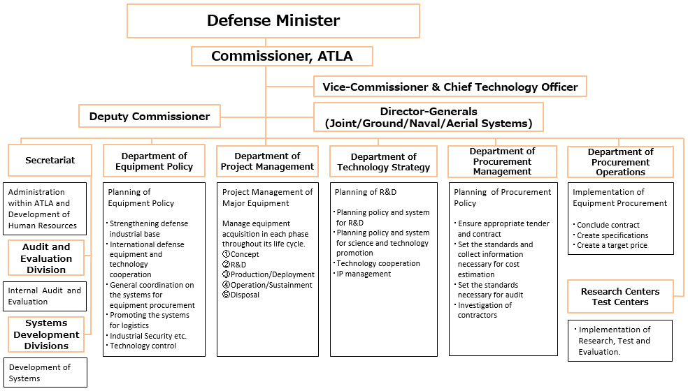
Notes:
This is the organizational chart of ATLA as it is presented in English.
Concerning procurement, the Department of Procurement Management and Department of Procurement Operations are of interest.
We will go into bit more detail into the organization in a later slide.

Slide 9
ATLA Missions
Ensure technological superiority and respond quickly to operational needs;
Efficiently acquisition defence equipment (Project management from concept study, R&D to production and operation);
Strengthening of defence equipment and technology cooperation with other countries;
Maintain and strengthen defence production and its technological basis in Japan;
Strive towards cost reduction and strengthen inspection and audit functions.
Notes:
English website of ATLA is more of a sales pitch of technologies developed by them in cooperation with Japanese industry and will give you little insight into the procurement needs of the organization.

Slide 10
ATLA: Types of procurement
Central procurement
Domestic procurement (kokunai choutatsu)
Procurement of domestically-made goods and services
Importation procurement (yunyuu choutatsu)
Procurement directly from abroad or via trading houses
Regular import procurement via trading houses (ippan yunyu chotatsu)
Foreign Military Sales (FMS) procurement
Procurement from US
Majority is single/limited tenders, no competition
Low marketability of products needed, Specialist suppliers, High-level and complex specifications, Long contracting periods
Notes:
Taken from Board of Audit Report https://report.jbaudit.go.jp/org/h19/2007-h19-1118-0.htm (2007)
FMS procurement through Foreign Military Sales (FMS) from the government of the United States (hereinafter referred to as the "U.S. government") based on agreements such as the "Mutual Defense Assistance Agreement between Japan and the United States of America" (Treaty No. 6 of 1954).
FMS in 2023 was 25% of the total procurement amount.
Single/limited tendering
This is the explanation ATLA give themselves as to why there is relatively little open competitive tendering in their procurement activities.
(Source: ATLA Yellow Book)

Slide 11
Joint R&D projects
ATLA
Australia: AUV development (Jan 2024)
UK: Next-gen RF-sensing system (Feb 2022)
UK: Chemical/Bio protection technologies (June 2021)
Australia: Hydrodynamic/hydro-acoustic performance of vessels (May 2021)
MOD
(UK/IT) Next Gen Fighter Aircraft (BAE, Leonardo, Mitsubishi Heavy Industries)
Innovative Science and Technology Initiative for Security (SBIR funding)
Notes:
These are some of the more recent international projects, conducted by ATLA.
There is of course the next-gen fighter project with UK and Italy, but this is more at MOD and company level. (Industry initiated is seems) Also inviting Saudi Arabia is considered November 2024)
SBIR
JMOD has conducted a competitive commissioned research program in order to find advanced civilian technologies, overseeing the contribution to future defence
Applications 76 since 2015.

Slide 12
Research Centres within ATLA
Defense Innovation Science and Technology Institute (DISTI)
Established October 2024 as a Japan-style DARPA/DIU
External programme managers
International links with foreign research and defense organizations
Joint US-Japan Global innovation challenge 2025 (with DIU)
Other research centres
Air Systems Research Center (AI, AUV, hypersonic missiles and counter-measures)
Ground Systems Research Center (EMP munitions, multi target munitions, UGV, CBRN counter-measures etc.)
Naval Systems Research Center (sonar technologies, propellor technology, long-range UUV etc.)
Future Capabilities Development Center (AI/cyber, space/sensors, laser technologies etc.)
Notes:
DISTI was recently established by MOD in Oktober last year, To fundamentally enhance the capabilities for generating defense innovations and groundbreaking equipment, the Defense Innovation Agency’s Defense Innovation Science and Technology Research Institute will be established at Ebisu Garden Place in October 2024.
Modelled after DARPA and DIU (Defense Innovation Unit) (Framework research)
FY2024 programme managers from academia and private sector, research ranges from materials sciences, electronics, life sciences, robotics, aerospace and AI (US DARPA)
Thus far mostly US (DIU) oriented activities. (Swedish minister of Defence visited in December)
Air Systems Research Center (Currently Air Battle AI Challenge to be held 4th) joint AUV platform with fighters
Ground Systems Research Center
Naval Systems Research Center
Future Capabilities Development Center

Slide 13
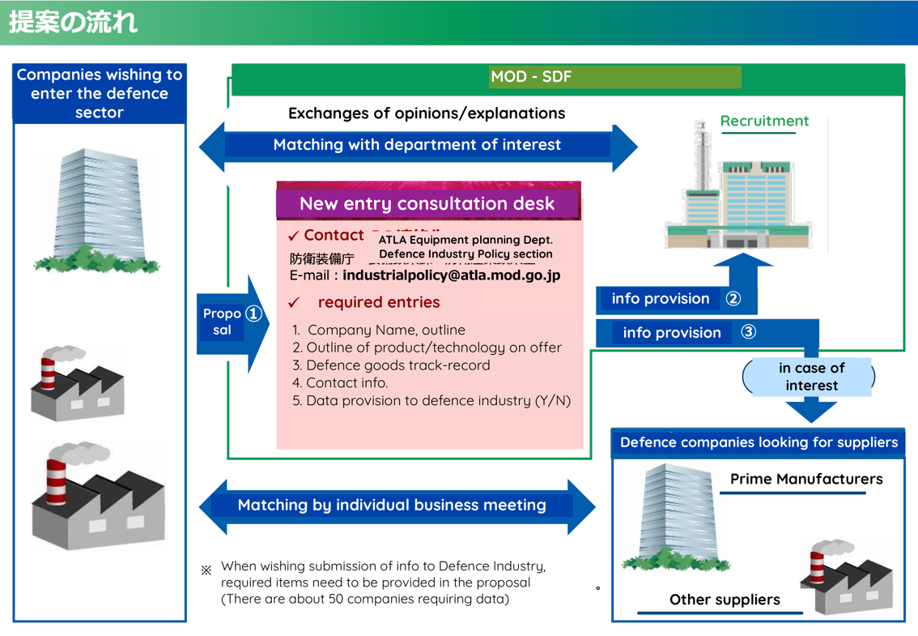

Promotion of access into defence industry
ATLA is actively recruiting companies to access the defence industry
primarily domestically oriented.
Startup technical evaluation
DIPEX (Defense Industry Promotion Exhibition)
Domestic companies only
https://www.mod.go.jp/atla/soubiseisaku_newentry.html
Notes:
MOD has about 10.000 SMEs as suppliers, but many are ceasing their business activities (ageing) Dependence on Foreign suppliers are usually as a risk in terms of supply and speed of repairs/service.
ATLA is undertaking various activities to stimulate companies and startups to access the defence sector, to strengthen its supply chains and integrated advanced technologies from the private sector.
https://www.mod.go.jp/atla/soubiseisaku_newentry.html
It is however likely that this is primarily domestically oriented but might provide opportunity if jointly proposed with Japanese partner. https://www.mod.go.jp/atla/soubiseisaku_newentry.html

Slide 14
Main Defence material suppliers
Company | Involved in supply /manufacturing of
Mitsubishi Heavy Industries | Fighter jets (F-15), Missiles (Patriot) , Helicopters, Frigates, destroyers, Submarines, Sub-marine systems (including UUVs), Battle Tanks, Tank Recovery vehicles, wheeled combat vehicles, UAVs, Laser systems, vertical launchers, High-speed glide missiles, next gen-fighter, Hypersonic guided missile prototype (research) and countermeasures; submarine launched guided missiles
SUBARU Corporation | Helicopters
Kawasaki Heavy Industries | Fixed wing aeroplanes (P1); submarines; Transport planes (C-2), Anti-ship guided missile research
Mitsubishi Electric | Mid-range surface-to-air missile guiding system improvement
Fujitsu | Defence security gateways service; Cloud infrastructure (IAAS)
Itochu Aviation | JSM (Kongberg) (For F-35)
NEC | Common cloud platform (JADSF); Central Cloud infrastructure (PAAS); Radar System, satellite connectivity
US | Osprey, Aegis systems, long range guide missiles, F-35 A/B, early warning systems,
Space One | Upper stage improvement research
With Northrop Grumman
click
Notes:
Data from FY 2023
F-2 and F-15J in license from US.
JSM (Ai-to-ship) Missiles

Slide 15
Top 20 suppliers in FY2023
Company | Number of contracts, examples of items supplied
1. Mitsubishi Heavy Industries | 255 contracts, including Island Defense High-Speed Glide Bomb (Enhanced Capability) (Part 1) Type 12 Surface-to-Ship Guided Missile (Enhanced Capability) UH-60J Search and Rescue Helicopter
2. Kawasaki Heavy Industries | 155 contracts, including P-1 Fixed-Wing Patrol Aircraft C-2 Transport Aircraft ; Research and Prototype Development of Element Technology for New Anti-Ship Guided Missile for Island Defense
3. NEC | 271 contracts, including Leasing of Electronic Computers Air Self-Defense Force Cloud System (Shared Platform) Leasing Equipment for Automatic Warning and Control System Broadband Multi-Purpose Radio
4. Mitsubishi Electric Corporation | 126 contracts, including Type 03 Medium-Range Surface-to-Air Missile (Improved Version) with Enhanced Capability Type 03 Medium-Range Surface-to-Air Missile (Improved Version Type 99 Air-to-Air Missile (B Variant)
5. Fujitsu Corporation | 139 contracts, including Services for Defense Security Gateway Leasing of Equipment for MSII Open Systems Leasing of Central Cloud Infrastructure (IaaS)

Slide 16
Top 20 suppliers in FY2023
Company | Number of contracts, examples of items supplied
6. Toshiba Infra Systems | 68 contracts, including Search Radar (HPS-106B for P-1 Use) Onboard Radio Wave Measurement Equipment Type 11 Short-Range Surface-to-Air Missile
7. IHI Corporation | 31 contracts, including Unmanned Underwater Vehicle OZZ-100 Next-Generation Fighter Aircraft (Part 4) (2) Engine System for Next-Generation Fighter Aircraft (Part 3) P-1 Engine (F7-10, Spare)
8. Hitachi Ltd. | 94 contracts, including Air Self-Defense Force Cloud System Security Services (Shared Security Sub-Services) Side-Scan Sonar Type 6 6. Leasing of Electronic Computers Air Self-Defense Force Cloud System (Base Infrastructure Security Monitoring Equipment)
9. Itochu Aviation Corporation (T) | 51 contracts, including JSM (Joint Strike Missile) (Kongsberg (NO)) High-Performance 20mm Machine Gun Upgrade Equipment C-2 Onboard Electronic Equipment Components (Imported, Part 3)
10. Japan Aerospace Exploration Agency | 3 contracts, including Space Situational Awareness (SSA) Satellite System Satellite (Part 2) Ground System (Part 3)
11. Nippon Steel | 19 contracts, including Research and Prototype Development of Future Railgun (Part 2) Wheeled Armoured Personnel Carrier (AMV) Type 19 Wheeled 155mm Self-Propelled Howitzer
Kongsberg, BOEING, Lockheed Martin, Raytheon, Northrop Grumman, Honeywell, Jeppesen, Acutronic, Plantronic, MKSI
Patria (FI) (Under license)
click
Notes:
Itochu is a specialized trading house. (Shosha)

Slide 17
Top 20 suppliers in FY2023
Company | Number of contracts, examples of items supplied
12. SUBARU | 39 contracts, including UH-2 Helicopters
13. Japan Marine United | 3 contracts, including Patrol Vessel (1.900 tonnes class) Design work for Aegis System equipped vessels
14. Idemitsu Kosan | 99 contracts, including Aviation fuel
15. Oki Electric Industry | 41 contracts, including Towed Passive Sonar Sonobuoy Sonar systems
16. ENEOS Corporation | 50 contracts, including Aviation fuel
17. Nakagawa Bussan Co., Ltd. (T) | 162 contracts, including Aviation fuel, kerosine
18. Sumisho Aero-Systems Corporation (T) | 54 contracts, including Measuring Instruments for Repairing Infrared Detection Equipment 84mm Recoilless Rifle (B Variant)
19. Komatsu Ltd. | 18 contracts, including Anti-tank shells
20. Mitsubishi Corporation (T) | 10 contracts, including Rockets Aircraft landing restraint system F-2 Targeting Pod
BAE, Airbus, Thales, RheinMetall, Saab, FN Herstal
click
Notes:
Japan Marine United: Engineering consultancy
Komatsu: Heavy Machinery manufacturing, has been involved in development of armoured vehicles but has withdrawn https://toyokeizai.net/articles/-/268241
Sumisho: Company in the Sumitomo Corporation group.
OKI: best known probably from the printers, but company has strength in providing public infrastructure solutions and sonar for defence, as well as submarine communications

Slide 18
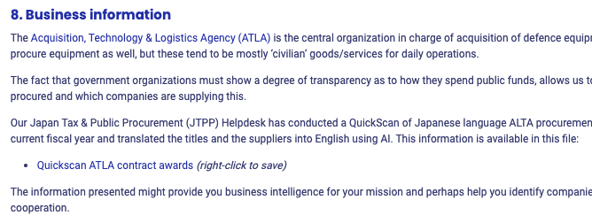
Market Quick scan
Available on Mission participant’s page (PW: JTPP2025)
Contracts concluded during FY 2024
Translations of contract titles and company names
Might provide leads to possible partners
Notes:
We can also see if we can invite these companies to the networking event or the booth.

Slide 19
Your Questions

Slide 20
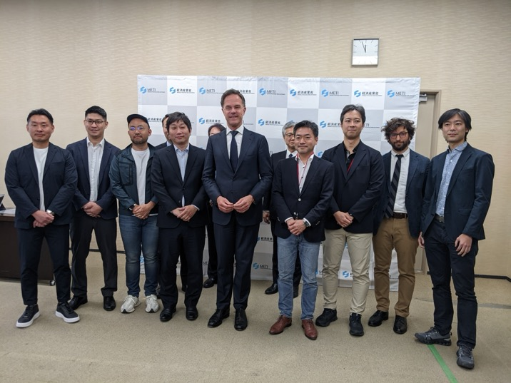
NATO Secretary Rutte met with Japanese Dual-use start-ups (April 9)
Companies present (click name for link):
ACSL | Drone manufacturer
VFR | Drone manufacturer
INNOPHYS | Muscle suit
Mitsufuji | Biometric information management
WOTA | Water recycling
Synspectiv e | Satellite communications
LQUOM | long-distance quantum communication technology
Sakana AI | AI
https://www.meti.go.jp/press/2025/04/20250409002/20250409002.html

