Slide 1

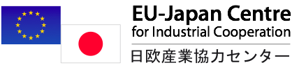
JTPP Helpdesk
Topic 1
Topic 2
Topic 3
Topic 4
Contact
EU-JAPAN EPA:
What impact on Government Procurement?
Lyckle Griek,
Japan Tax & Public Procurement Helpdesk Project manager
www.EUbusinessinJapan.eu

Slide 2
Today’s topics
Topic 1
Topic 2
Topic 3
Topic 4
Contact
What has been agreed upon between EU and Japan regarding government procurement
Additional provisions on top of WTO GPA
Market access/Coverage
Railways
Some guess work…
Conclusion
eu-japan.eu

Slide 3
The EU-Japan agreement (JEFTA) on
Government Procurement
Topic 1
Topic 2
Topic 3
Topic 4
Contact
Builds upon mutual obligations already laid down in WTO Agreement of Government Procurement (GPA)
i.e. rules laid down in the WTO GPA plus:
EPA/FTA provides
additional scope of application
Larger access
eu-japan.eu

Slide 4
Additional Rules agreed:
Topic 1
Topic 2
Topic 3
Topic 4
Contact
Publication of Notices:
“Notices of intended and planned procurement to be directly accessible by electronic means free of charge through a single point of access on the Internet”
Already present at http://www.jetro.go.jp/en/database/procurement/ or https://kanpou.npb.go.jp/index.html (Government Gazette)
Conditions for participation:
Suppliers shall not be excluded on the basis of a legal requirement that it must be either a natural person or a legal person
Relevant prior experience in Japan may not be set as condition
eu-japan.eu

Slide 5
Additional Rules agreed:
Topic 1
Topic 2
Topic 3
Topic 4
Contact
Supplier Qualifications:
Interested suppliers may request registration at any time, and procuring entity should give result of application in reasonably short time.
Qualifications for construction work in Japan
Keishin Business evaluation
Assess in a non-discriminatory manner and recognize as accomplishments achieved by suppliers outside of Japan as equivalent. (such as technical staff numbers, labour welfare conditions, year in business, conditions of accounting in construction business, R&D expenditures, ISO certification, employement of younger staff, amount of sales, but also financial figures such as equity capital, EBITDA, equity ratios etc.)
eu-japan.eu

Slide 6
Additional Rules agreed:
Topic 1
Topic 2
Topic 3
Topic 4
Contact
Selective Tendering
When limiting the number of suppliers it shall be sufficient to ensure competition,
for Japan applies only for central government entities.
Not much gained here, very little WTO regulated Selective tendering
Technical Specifications
use of environmental-friendly technical specifications, that should be appropriate to define characteristics of supplies and services required; that they be objectively verifiable and non-discriminatory and accessible to all.
Test reports
Mutual recognition of test reports
eu-japan.eu

Slide 7
Additional Rules agreed:
Topic 1
Topic 2
Topic 3
Topic 4
Contact
Treatment of tenders and awarding of contracts
Ensure that procuring entities are entitled to choose between evaluation criteria of
a) most advantage tender and
b) price
Verify that granting of subsidies is also taken into account
Domestic Review Procedures
Additional agreements on
Independence of members of the complaints’ authorities
Qualifications of members of the complaints’ authorities
Suspension of procedures in case of complaint
Concrete corrective actions in case of challenge
eu-japan.eu

Slide 8
Other articles
Topic 1
Topic 2
Topic 3
Topic 4
Contact
Mostly technical in nature
Exchange of statistics
Procedures in case of modifications and rectifications to coverage
Consultations and dispute resolution
Establishment of a Committee on Government Procurement
eu-japan.eu

Slide 9
Market Access
Topic 1
Topic 2
Topic 3
Topic 4
Contact
FTA will give EU greater market access
Central government (GPA, Annex 1) | FTA will apply to all government entities belonging to this category
Sub-central government (GPA, Annex 2) | Additional designated city: Kumamoto City Local independent administrative agencies Procurement related to production, transport and distribution of Electricity
Other entities (GPA, Annex 3) | Lower thresholds for entities in Group B: Goods/Services 150,000 -> 100,000 SDRs 6 entities added
Information Technology Promotion Agency;
Pharmaceutical and Medical devices Agency;
Japan Community Healthcare Organization;
Agriculture, Forestry and Fisheries Credit Foundation;
National Agency for Automotive Safety and Victims’ Aid; and
Organization for Environment Improvement around International Airport.
eu-japan.eu

Slide 10
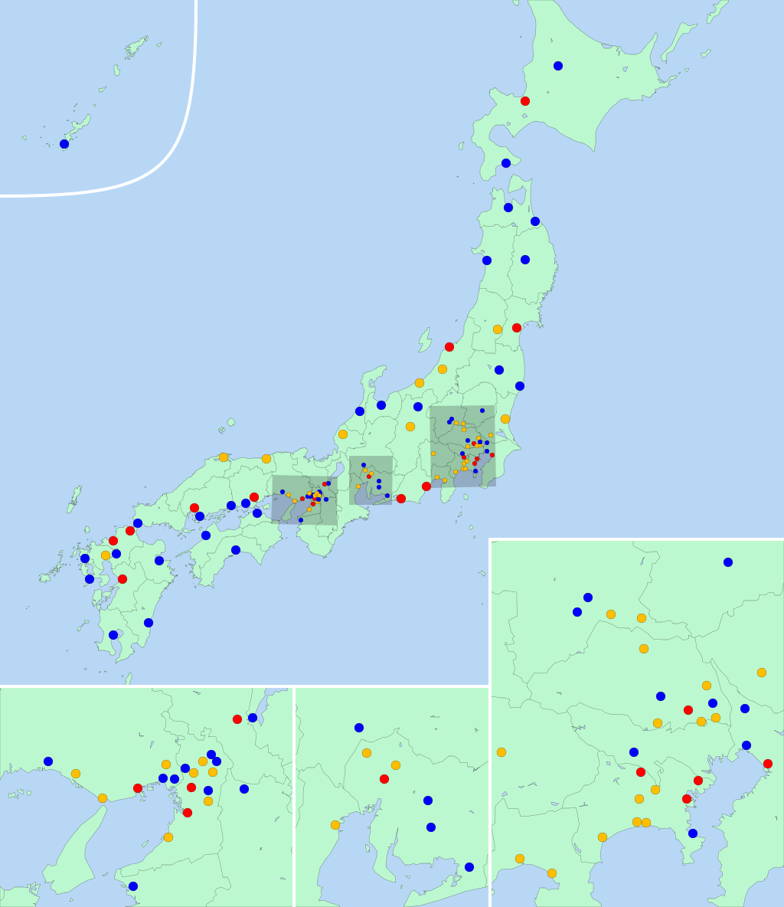
Market Access
Topic 1
Topic 2
Topic 3
Topic 4
Contact
Core cities’ procurement
Procurement in open competitive procedures by (currently) 54 cities, with population > 200,000 →EU companies get equal access
Thresholds same as sub-central government entities
 | JPY | EUR (est.)
Goods/services | 30 mln | 240,000
Construction services | Not covered | -
Architectual, engineering and Other technical services related to construction | Not covered | -
Services other than above | 30 mln | 240,000
eu-japan.eu

Slide 11
Railways
Topic 1
Topic 2
Topic 3
Topic 4
Contact
Operational Safety Clause (OSC) removed for EU suppliers
” Procurement related to operational safety of transportation is not covered.”
Transportation related procurement by
Sub-central governments
Designated and core cities
JR Hokkaido
JR Shikoku
JR Freight
JRTT
Tokyo Metro Co. Ltd.
Open* for EU suppliers
* Threshold > 400,000 SDR
eu-japan.eu

Slide 12
Additional coverage: services
Topic 1
Topic 2
Topic 3
Topic 4
Contact
Central government entities
754 Telecommunications related services 812 Insurance (including reinsurance) and pension fund services, except compulsory social security services 87201 Executive search services 87202 Placement services of office support personnel and other workers 87204 Supply services of domestic help personnel 87205 Supply services of other commercial or industrial workers 87206 Supply services of nursing personnel 87209 Supply services of other personnel 87501 Portrait photography services 87502 Advertising and related photography services 87503 Action photography services 87505 Photography processing services | 87506 Motion picture processing services not related to the motion picture and television industries 87507 Restoration, copying and retouching services of photography 87509 Other photographic services 87901 Credit reporting services 87902 Collection agency services 87903 Telephone answering services8 7905 Translation and interpretation services 87906 Mailing list compilation and mailing services 87907 Specialty design services
eu-japan.eu

Slide 13
Additional coverage: services
Topic 1
Topic 2
Topic 3
Topic 4
Contact
Sub-central government entities
^{643 Beverage serving services} 83106 to 83108 Leasing or rental services concerning agricultural machinery and equipment without operator 83203 Leasing or rental services concerning furniture and other household Appliances 83204 Leasing or rental services concerning pleasure and leisure equipment 83209 Leasing or rental services concerning other personal or household goods 86501 General management consulting services 86502 Financial management consulting services (except business tax) 86503 Marketing management consulting services 86504 Human resources management consulting services 86505 Production management consulting services 86509 Other management consulting services
eu-japan.eu

Slide 14
Some guesswork…
Topic 1
Topic 2
Topic 3
Topic 4
Contact
As of yet, still little detailed information available
Practical elaborations
Railway companies will set up more transparent procurement websites
Character of the market will remain the main determinant
English language information provision
Rumor: Core cities do not need to publish English summaries
Administrative procedures (supplier qualifications etc.) improvement
Online procedures
Practical workings of challenging system remain unclear
Potential: more opportunities for high tech machinery, railways, service provision and medical sector
eu-japan.eu

Slide 15
Conclusion
Topic 1
Topic 2
Topic 3
Topic 4
Contact
Impact? Too early to say
Benefits for EU SMEs still up in the air
More transparency?
Possible opportunities
Technical and medical equipment
Railways?
JEFTA and public procurement: Still some patience needed!
eu-japan.eu

Slide 16
Q&A
Topic 1
Topic 2
Topic 3
Topic 4
Contact
Your questions…
Visit us at eu-japan.eu
eu-japan.eu

